Slide 1

Sawdays
Solution Diagram for Assignment

Slide 2




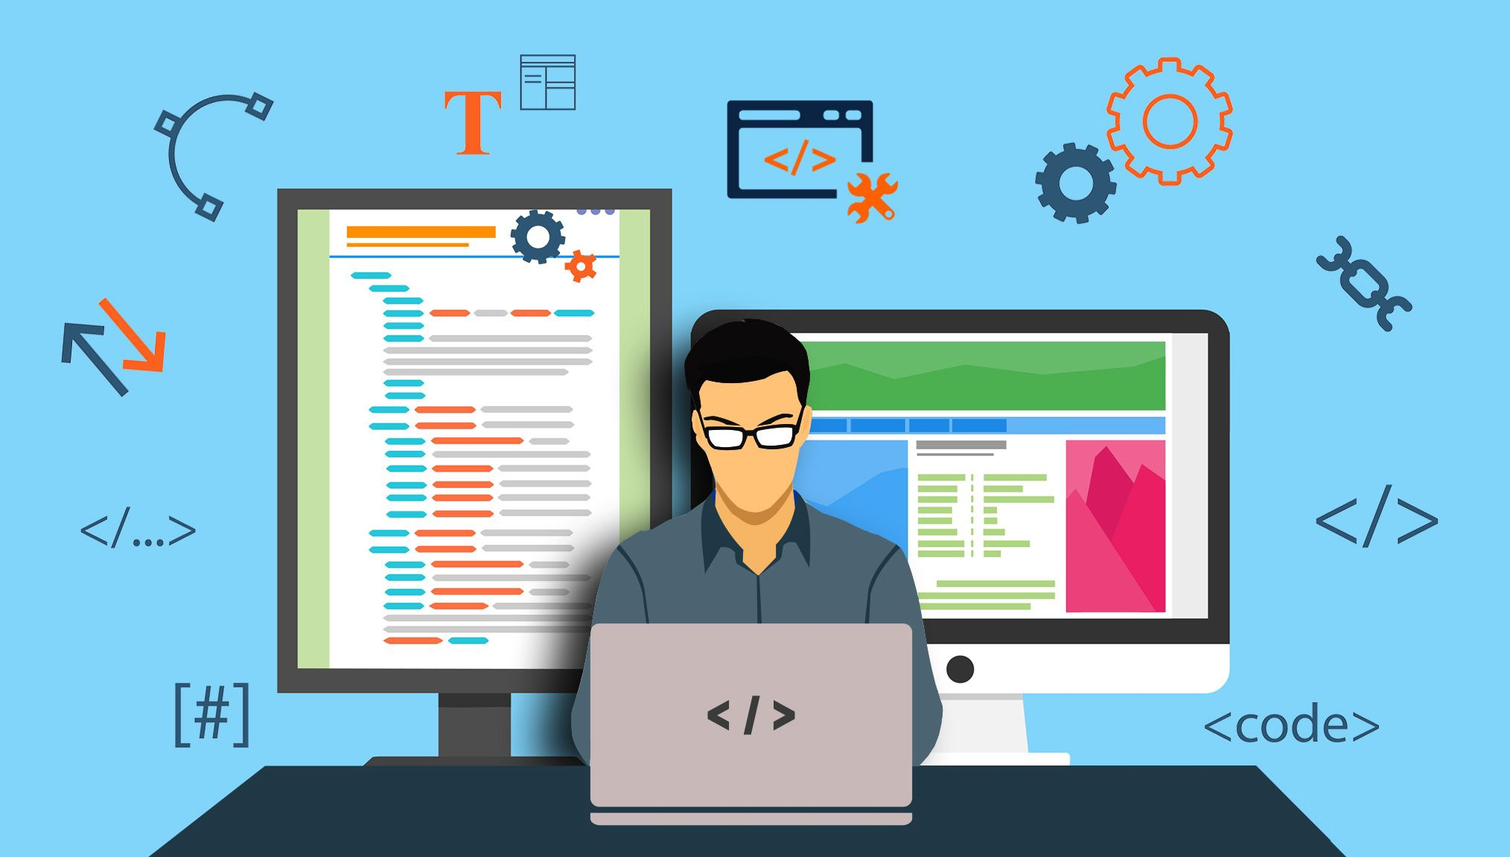


CI and CT
Code Push
Compile, Test and Package
Continuous build
Master branch
Processed .WAR file
Lead Developer
Functional Testing
Review branch
Feedback about the code
Code Developers
Build other job if this build is stable

Slide 3


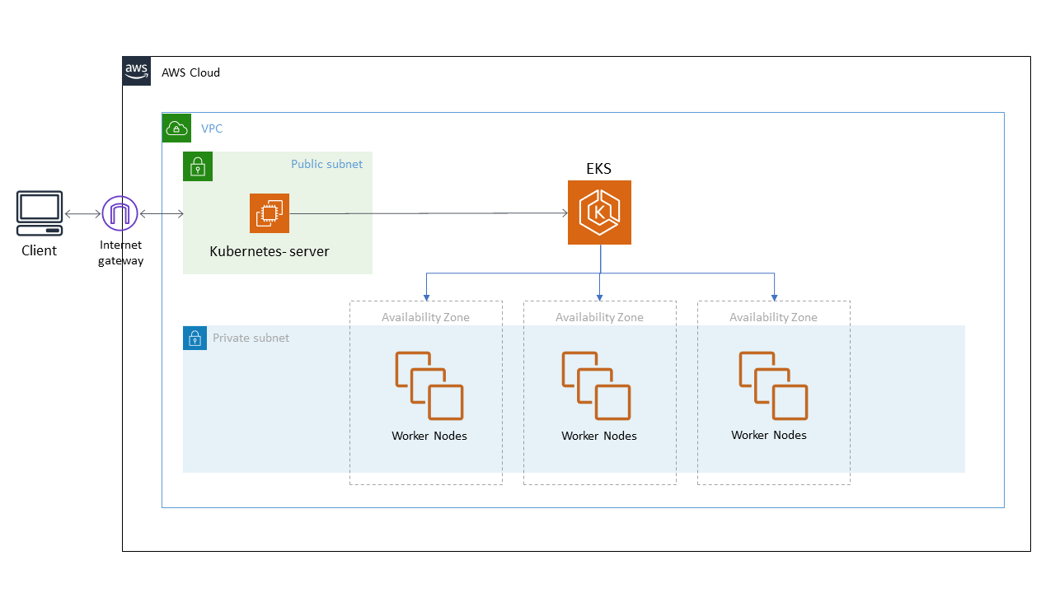


CD and CD
Docker Image
Push
Continuous delivery
Docker Image
Pull
Continuous deployment
Deploy on Dev Env
Build other job if this build is stable
Deploy on Prod Env

